Slide 1

Cyber Resilience in the Energy Sector
P. T. D. Minipura
IT23298408

Slide 2

Abstract
Energy sector is vital to modern economies, heavily reliant on digital technologies.
This reliance increases vulnerability to cyberattacks (e.g., ransomware, state- sponsored attacks).
Cyber resilience is essential for mitigating risks and ensuring continuity.
Key focus areas:
Components of cyber resilience.
Major cyber threats to the energy sector.
Role of AI, blockchain, and quantum computing in enhancing protection.
Goal: Ensure resilience, minimize disruptions, and enable swift recovery.

Slide 3
Introduction
• Energy sector’s growing reliance on digital infrastructure.
• Importance of cyber resilience due to increasing cyber threats.

Slide 4
Key Components of Cyber Resilience
• Risk Assessment
• Robust Cybersecurity Controls
• Incident Response Planning
• Business Continuity & Disaster Recovery
• Employee Training & Awareness

Slide 5
Cyber Threats in the Energy Sector
• Ransomware (e.g., Colonial Pipeline attack)
• Nation-state attacks (e.g., Ukraine Power Grid attacks)
• Insider threats
• Supply chain vulnerabilities

Slide 6
Evolution of Cybersecurity
• Transition from traditional cybersecurity to cyber resilience.
• Notable incidents: Stuxnet, Shamoon, Dragonfly attacks.

Slide 7
Technological Advancements in Cyber Resilience
• AI and Machine Learning for threat detection.
• Blockchain for data integrity and decentralized security.
• Quantum computing and its future impact on encryption.

Slide 8
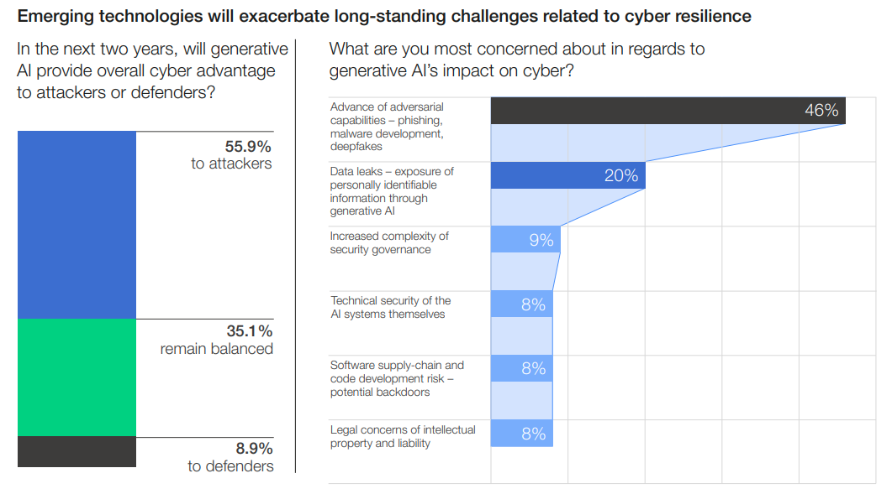
The Forum’s Global Cybersecurity Outlook 2024 revealed almost 56% of leaders believe emerging technologies will hand an advantage to cyber attackers.

Slide 9

Regulations and Standards
• US: Cybersecurity Information Sharing Act (CISA)
• EU: NIS Directive
• UK: Energy Security Strategy
• Australia: Cybersecurity Strategy 2020

Slide 10
Future Developments
Adoption of Zero-Trust Architecture.
Increased focus on supply chain security.
Integration of blockchain and quantum computing.

Slide 11
Training and Awareness
• Importance of continuous employee training.
• Mock phishing attacks and hands-on cybersecurity training.

Slide 12

Conclusion
Cyber resilience is critical for the energy sector’s future.
Technology, regulation, and human awareness are key to strong defenses.

Slide 13


